Slide 1


Health Insurance Analysis
Analyzing U.S. Medical Cost Drivers to Guide Allianz Germany’s Market Entry Strategy
Analyzing health cost trends to support market entry and risk-based pricing
1

Slide 2

Welcome, and thank you for joining us in today’s presentation, we’ll explore how data analytics reveals the key drivers of U.S. medical insurance costs, helping Allianz Germany design fair, competitive, and risk-adjusted pricing strategies for market entry.
Sruthi Thulasi Das
🎓 Bachelor‘s degree in Computer Science
💼 Aspiring Data Analyst | Web Developer
🌍 Focusing on Data Analytics roles in Germany
🔗 Connect with me:
LinkedIn: https://www.linkedin.com/in/sruthi-thulasi-das-547103152/
GitHub: https://github.com/Sruthi-t-das
2

Slide 3

TOOLS
3

Slide 4

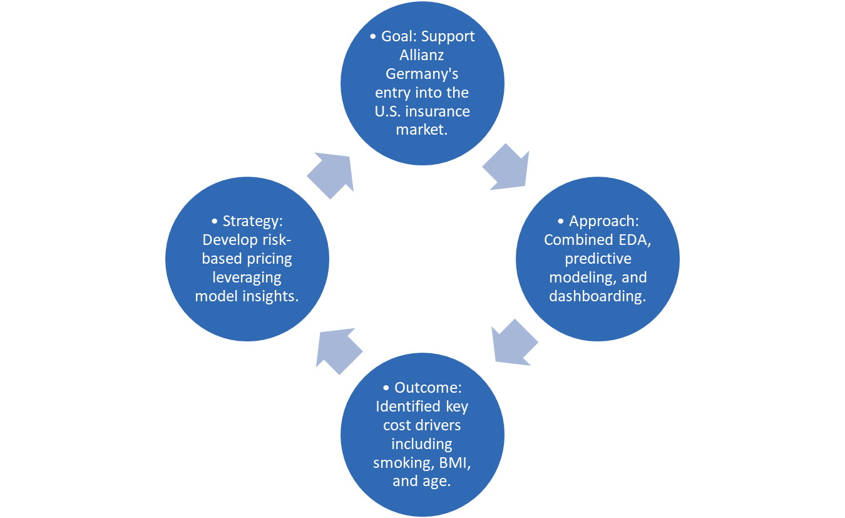
Executive Summary
4

Slide 5

👥 StakeholderView
Allianz Germany’s Pricing and Underwriting Team
Goals
Develop risk-based premium plans using medical and demographic data.
Avoid underpricing high-risk individuals (e.g., smokers, obese, chronically ill).
Attract low-risk, healthy customers with competitive, fair premiums.
Build a sustainable and data-informed market entry strategy in the U.S.
5

Slide 6

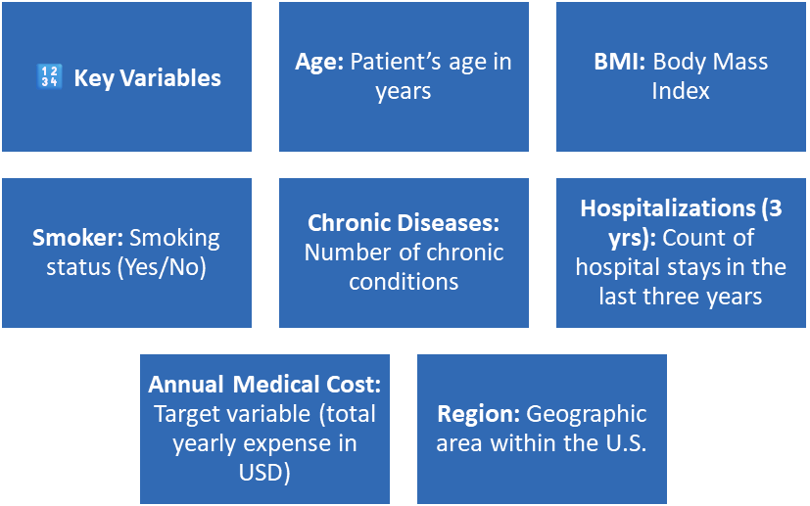


Dataset Overview
•Source: U.S. Medical Insurance dataset
•Size: 100000 records
•Features: 7 attributes
•Type: Structured tabular data combining demographics, lifestyle, and medical indicators
Focus: Demographics + Lifestyle + Health data → Predict annual medical cost
6

Slide 7


Hypotheses
To identify the main factors influencing annual medical costs, the following hypotheses were formulated:
H1
Smoking significantly increases annual medical cost.
H2
Higher BMI leads to higher annual medical cost.
H3
Age is positively correlated with annual medical cost.
H4
Individuals with chronic diseases have higher annual medical costs.
H5
Individuals with more hospitalizations over the past three years have higher annual medical costs.
7

Slide 8

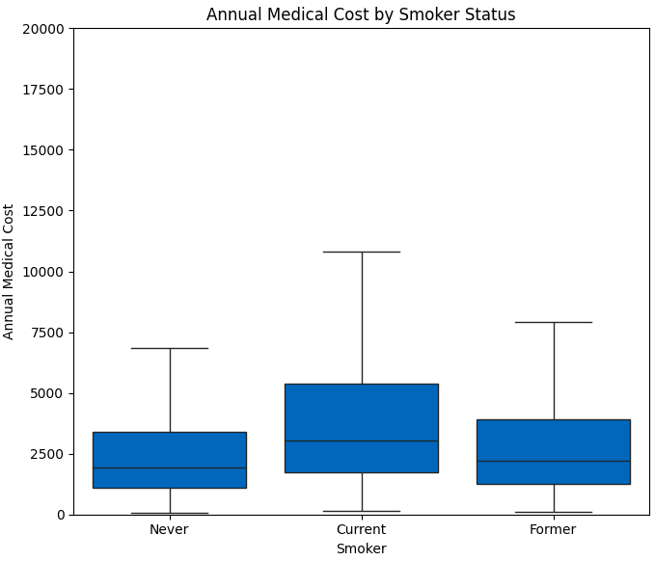
Hypotheses 1
Individuals who smoke will have higher annual medical costs than non-smokers, due to elevated health risks and higher incidence of chronic diseases.
8

Slide 9
Analysis & Insights
Average medical costs for current smokers are significantly higher than for non-smokers.
Box plot clearly shows higher median and upper quartile values among smokers, indicating more high-cost outliers.
Former smokers also show moderately higher costs, likely due to residual health effects.
Findings support H₁, confirming smoking is a key cost driver for insurers.
9

Slide 10

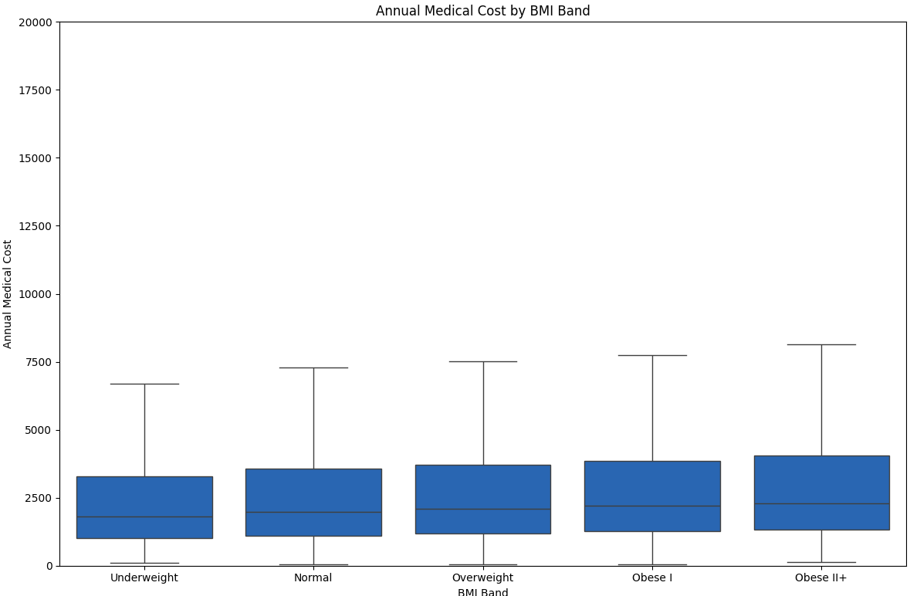
Hypotheses 2
Individuals with higher BMI (Body Mass Index) will have higher annual medical costs due to increased health risks and chronic conditions.
10

Slide 11
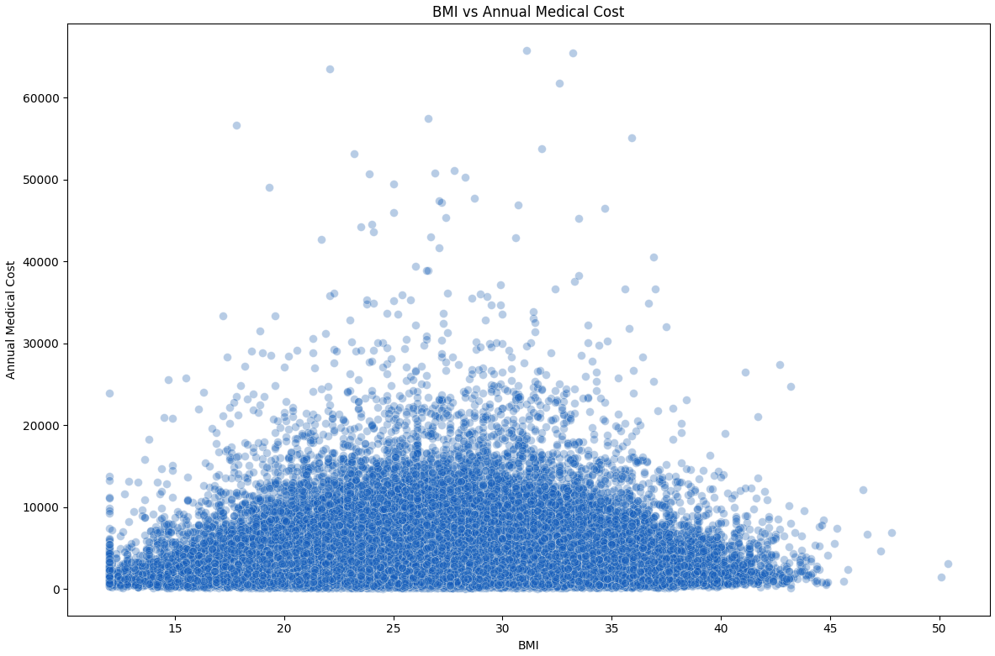
Analysis & Insights
The scatter plot indicates a moderate positive relationship between BMI and annual medical cost — costs generally rise with BMI but not in a strictly linear pattern.
Box plot by BMI band shows that individuals in the “Obese I” and “Obese II+” groups have noticeably higher median costs.
Cost variation widens among higher BMI groups, indicating greater unpredictability in medical expenses.
Findings partially support H₂, confirming BMI’s influence on medical costs, though the relationship is not perfectly linear.
11

Slide 12

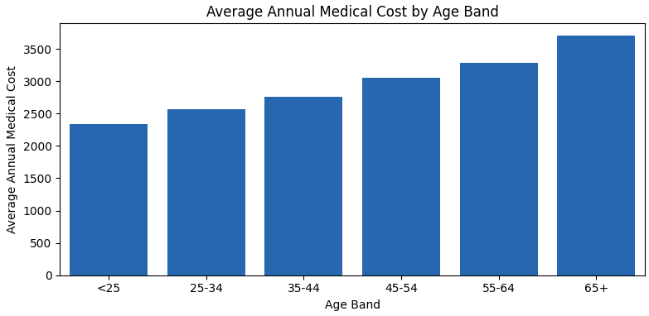
Hypotheses 3
Age is positively correlated with annual_medical_cost.
12

Slide 13
Analysis & Insights
The bar chart shows a clear upward trend in annual medical costs with increasing age.
The 65+ age group has the highest average medical expenses, followed by the 55–64 range.
This pattern suggests that age is positively correlated with annual medical costs.
Findings strongly support H₃, confirming that medical costs rise progressively with age due to age-related conditions and healthcare utilization.
13

Slide 14

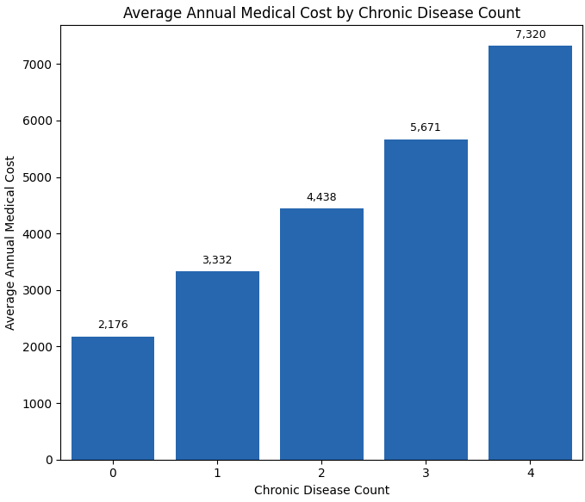
Hypotheses 4
Individuals with chronic diseases have higher annual medical costs.
14

Slide 15
Analysis & Insights
The chart shows a strong positive correlation between the number of chronic diseases and annual medical cost.
Medical costs rise consistently from around $2,000 (no chronic conditions) to over $7,000 for four chronic diseases.
This linear upward trend indicates that chronic illness burden is a key cost driver.
Findings strongly support H₄, confirming that each additional chronic condition leads to a significant increase in average annual expenses.
15

Slide 16

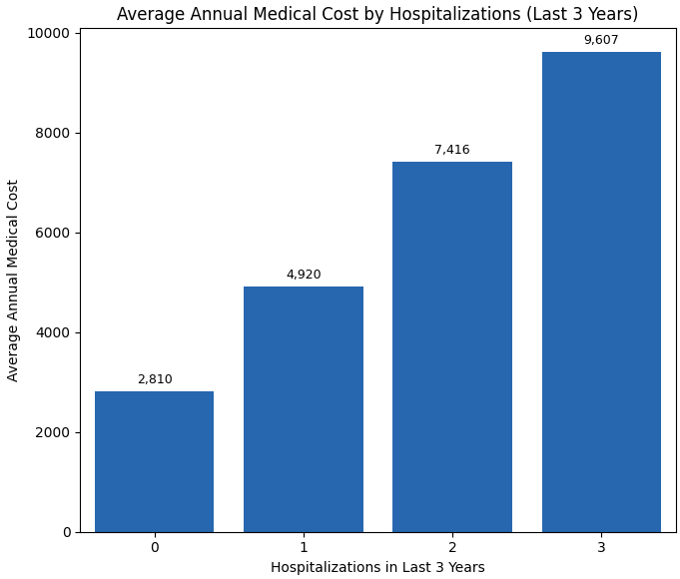
Hypotheses 5
Individuals with more hospitalizations over the past 3 years have higher annual medical costs.
16

Slide 17
Analysis & Insights
The chart shows a strong, almost linear rise in annual medical costs with the number of hospitalizations.
Average cost increases from $2,810 (no hospitalizations) to nearly $9,600 for three hospitalizations.
This demonstrates that frequent hospital stays are a major contributor to total medical expenses.
Findings strongly support H₅, confirming hospitalization frequency as a critical driver of cost escalation.
17

Slide 18
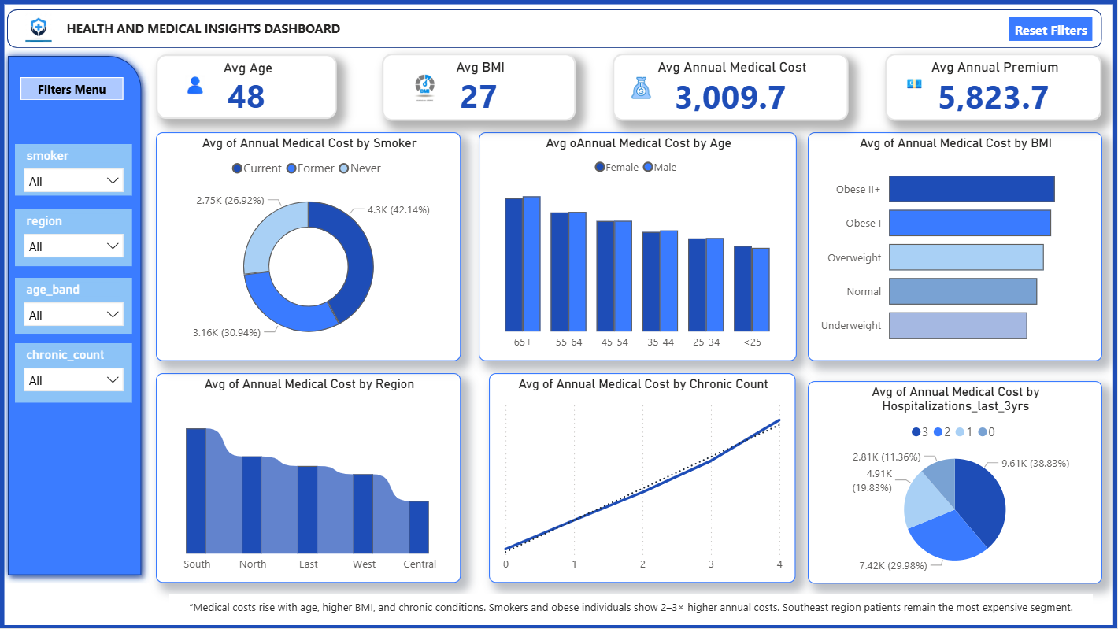
Interactive Dashboard Exploration - POWERBI
The dashboard allows:
Filter by smoker status, region, age, and chronic conditions
Compare costs dynamically across different risk groups
Visualize trends in real time with dynamic cards and charts
18

Slide 19

19

Slide 20
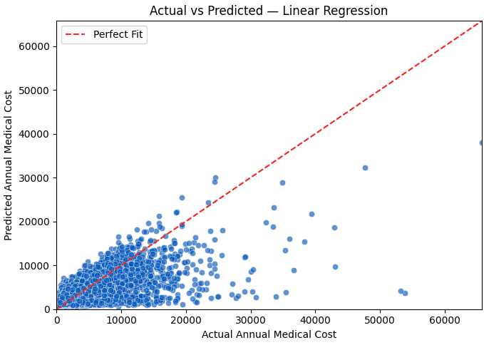
Predictive Modeling Insights
Linear Regression - Base Model
Mean Absolute Error (MAE): 1,430
R² (Model Accuracy): 0.44
The model explains 44% of the variation in medical costs — reasonable for real-world healthcare data.
Indicates nonlinear influences and interaction effects not fully captured by a simple regression.
Smoking, BMI, and Chronic Disease Count emerge as the strongest cost predictors.
20

Slide 21
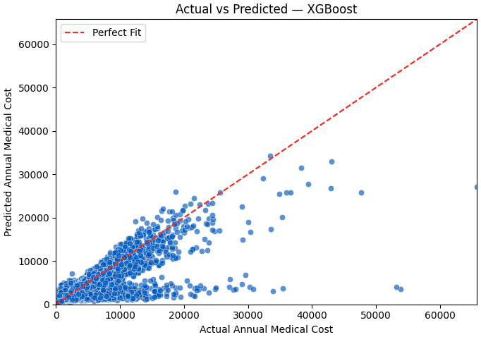
Predictive Modeling Insights
XGBoost - Advanced Model
Mean Absolute Error (MAE): 943.60
R² (Model Accuracy): 0.631
XGBoost model improved accuracy from 0.44 → 0.63 R², showing stronger predictive capability.
Captures non-linear relationships between lifestyle (smoking, BMI) and cost.
Reduces error margins significantly, making it more reliable for premium pricing simulations
21

Slide 22
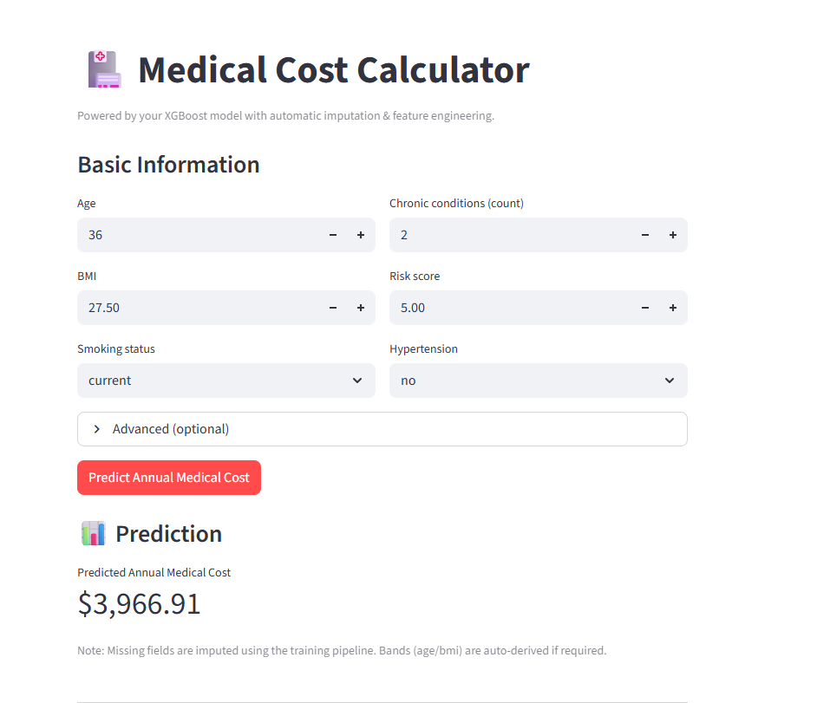
Medical Cost Prediction App
22

Slide 23

RECOMMENTATIONS
Apply higher premiums for smokers and introduce “Quit & Save” incentives to encourage healthy behavior.
Use BMI as a moderate risk factor and offer wellness-based discounts for maintaining healthy weight levels.
Implement age-tiered pricing and design senior-specific plans with preventive health coverage.
Include chronic-care management benefits and health monitoring programs in policy design.
Offer post-hospital recovery plans and preventive care initiatives .
23

Slide 24
RECOMMENTATIONS
Market Entry Approach
Enter the U.S. market with selective premium strategies to undercut high national averages.
Focus first on low-risk, low-claim segments to build brand trust and profitability.
24

Slide 25


25

Slide 26


26

Slide 27

Thank You
27

